Slide 1
Product Inventory Management System
PROJECT OVERVIEW
The Product Inventory Management System is a backend-focused web application developed using Node.js, Express.js, and MongoDB, designed to provide a secure and scalable solution for managing product data through RESTful APIs. The system enables users to create accounts, log in securely, and access protected routes using JWT-based authentication, ensuring that only authorized users can perform operations. It supports complete CRUD functionality, allowing users to add new products, view their inventory, update product details such as price or quantity, and delete items when needed.
Key Objectives:
Provide secure JWT-based user authentication and authorization for protected API access.
Enable efficient product inventory management through RESTful CRUD operations.
Ensure user-specific data isolation so each user can manage only their own products.
Implement scalable backend architecture using Node.js, Express.js, and MongoDB.
Deliver fast and reliable API responses with proper validation and error handling.
Target Users:
Small business owners managing product stock and inventory records.
Freelancers or sellers tracking items or services in a structured way.
Developers learning backend API development and authentication workflows.
Students working on backend or full-stack development projects.
Anyone needing a secure and simple backend system for managing product data.
PROJECT INSTRUCTION
Create backend project folder
Configure server using Express.js
Setup MongoDB database connection
Implement authentication APIs
Implement product CRUD APIs
Test APIs using Thunder Client in VS Code

Slide 2
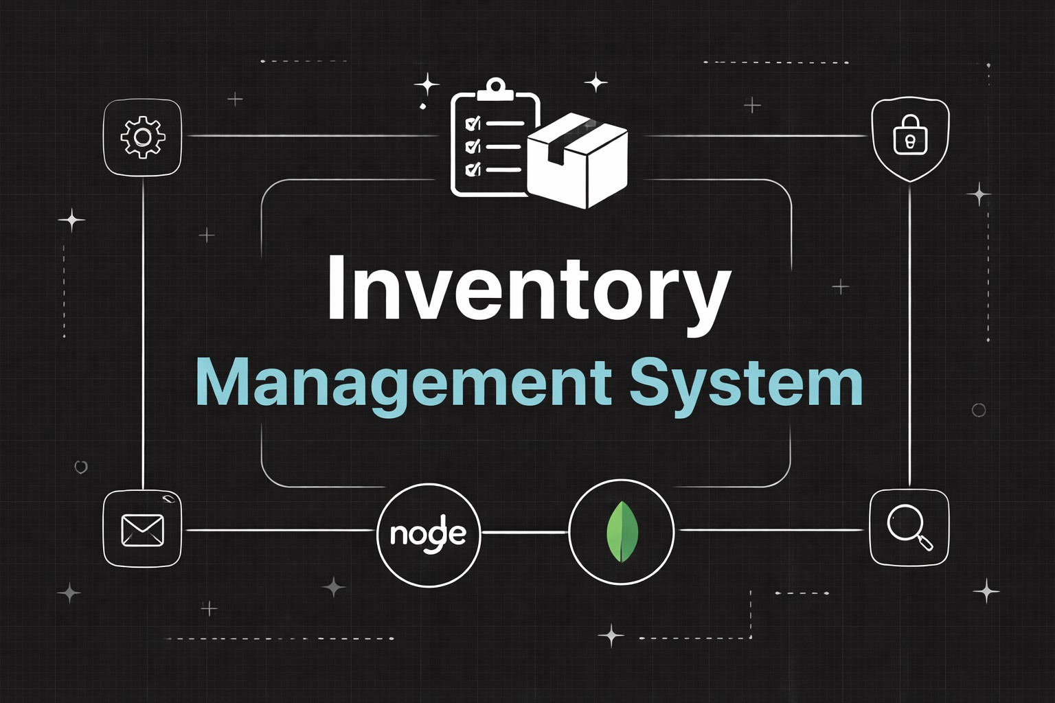
PRE-REQUISITES
Software | Purpose
Node.js | JavaScript runtime for backend
MongoDB | Database storage
npm | Package manager
VS Code | Development environment
Knowledge Requirements
JavaScript ES6 concepts
Node.js and Express.js REST API development
MongoDB and Mongoose ODM
JWT authentication
Middleware architecture
Project Thumbnail:

Slide 3
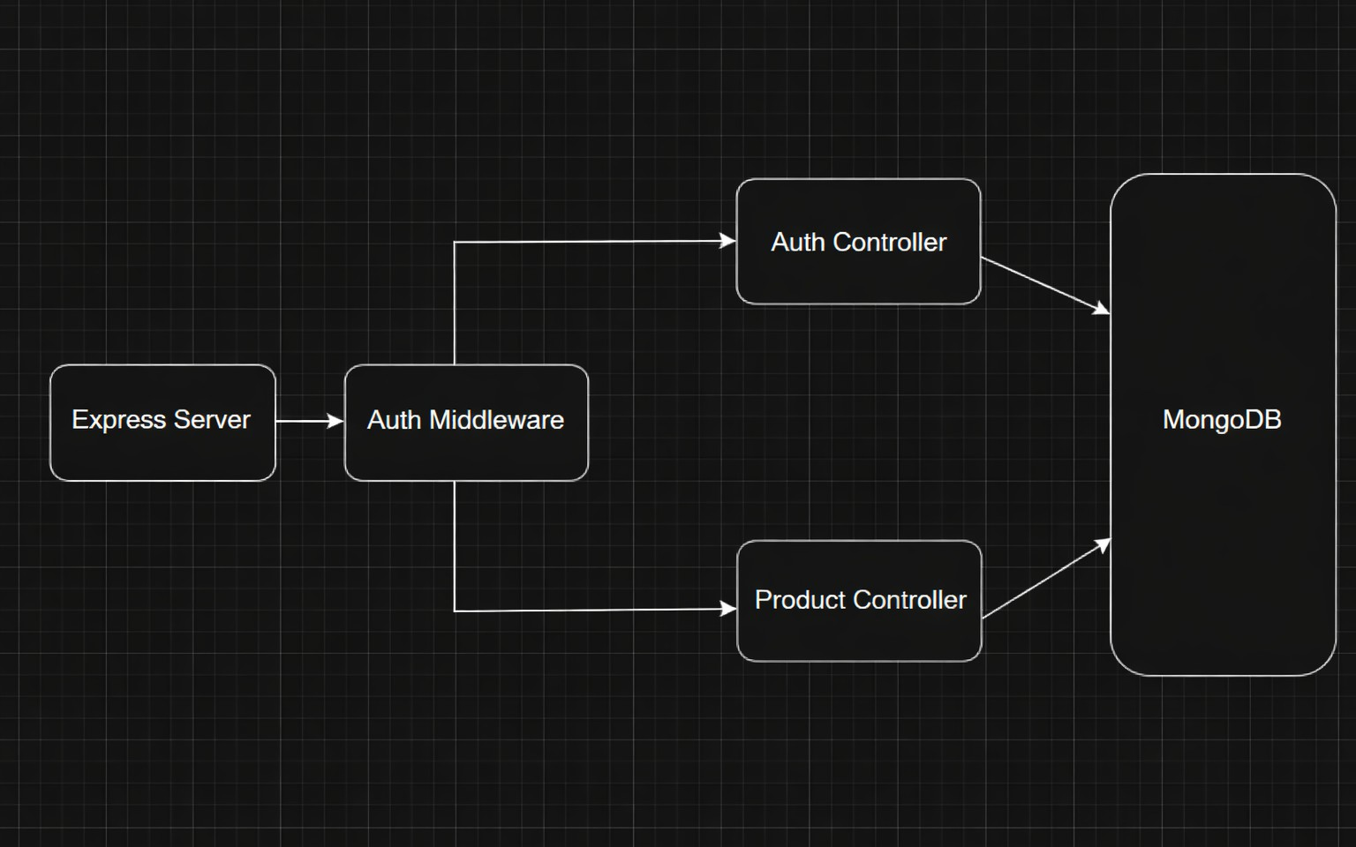
PROJECT ARCHITECTURE
High-level architecture diagram illustrating the three-tier backend structure.
Node.js + Express Backend
RESTful API architecture
JWT authentication middleware
MVC pattern (Models, Controllers, Routes)
Input validation and error handling
MongoDB Database
Document-based NoSQL storage
Mongoose ODM for schema modeling
Two collections: Users and Contacts
Indexed fields for optimized queries
TECHNICAL ARCHITECTURE
Backend Architecture (Node.js + Express)
Controllers: Handle authentication and product logic
Models: Define database schema
Routes: API endpoints for authentication and products
Middleware: JWT verification and error handling
Configuration: Environment variables and database connection

Slide 4
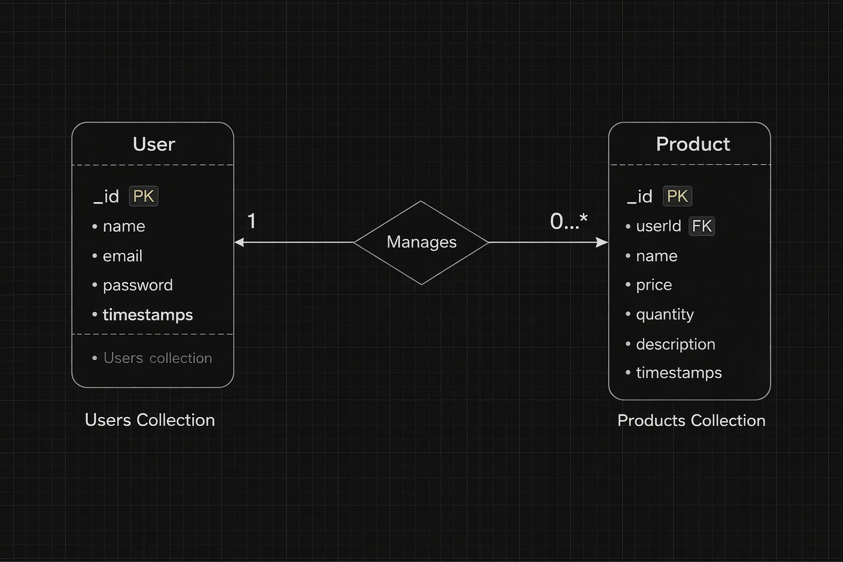
Database Architecture (MongoDB)
Users Collection:
_id
name
email
password (hashed)
timestamps
Products Collection:
_id
userId (reference to user)
name
price
quantity
description
timestamps
Relationship: One User → Many Products
Indexes:
email (unique)
userId
product name
ER Diagram
ER diagram showing User → Product relationship:

Slide 5
Features:
Core Features
S.No | Feature | Description
1 | User Authentication | JWT-based register and login system
2 | Product CRUD | Add, view, update and delete products
3 | Private Data Access | Users access only their own products
4 | Product Search | Search products by name
5 | Secure API | Middleware protected routes
Roles and Responsibility
User
Registration: Register using name, email and password
Login: Login using registered credentials
Add Product: Create product with name, price, quantity and description
Edit Product: Update existing product
Delete Product: Remove product from inventory
Search Product: Search products using keyword
User Flow
The user sends a register/login request.
The backend generates a JWT token.
The user sends a token in the Authorization header.
Middleware verifies the token.
The controller performs CRUD operations.
MongoDB stores or retrieves product data.
API sends response.

Slide 6
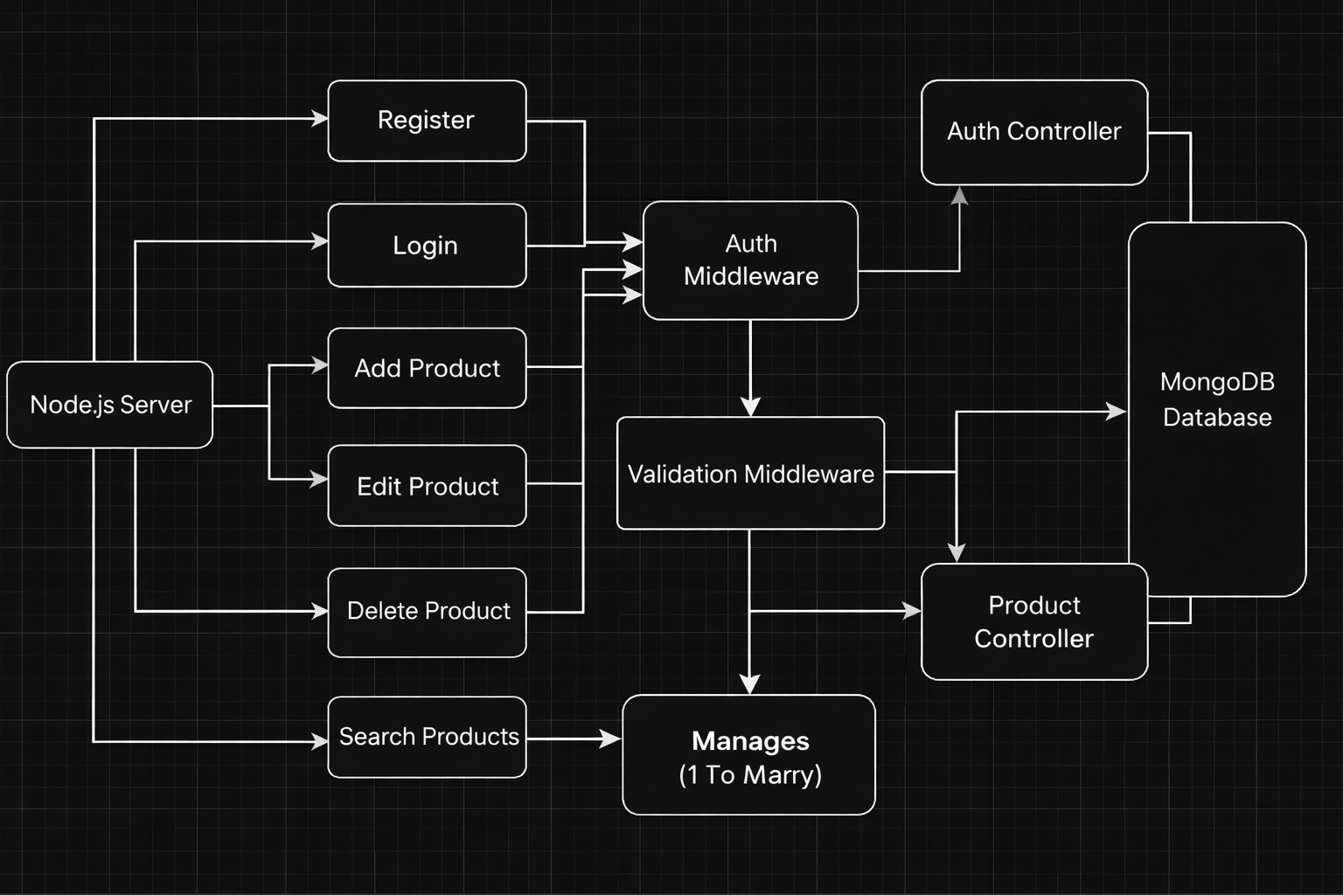
Project Setup and Configuration
Folder Structure
server/
│
├── node_modules/
├── src/
│ ├── controllers/
│ ├── db/
│ ├── middlewares/
│ ├── models/
│ ├── routes/
│ └── server.js
│
├── .env
├── .gitignore
├── package-lock.json
└── package.json

Slide 7
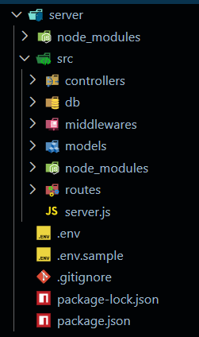
Initialize Node.js Project:
Open terminal inside the server folder and run:
npm init -y
This creates the package.json file which manages project dependencies.
Install Required Packages:
Install backend dependencies:
npm install express mongoose cors dotenv jsonwebtoken bcryptjs
Package Purpose:
express → Backend framework
mongoose → MongoDB connection
cors → Cross-origin requests
dotenv → Environment variables
jsonwebtoken → Authentication
bcryptjs → Password hashing
Create Environment File:
Create a file in the root of the server folder.
Example:
.env

Slide 8
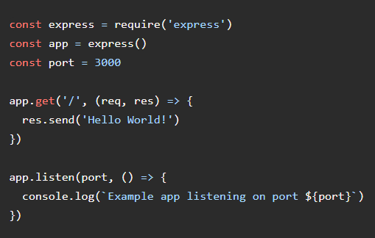
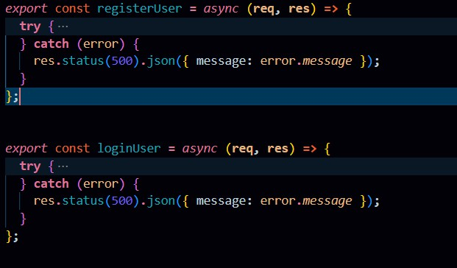
PORT=5000
MONGO_URI=your_mongodb_connection_string JWT_SECRET=your_secret_key
Backend Development
Setup Express Server:
Inside src/server.js, create the basic Express server.
Create Controllers Inside: src/controllers/ Create: auth.controller.js

Slide 9
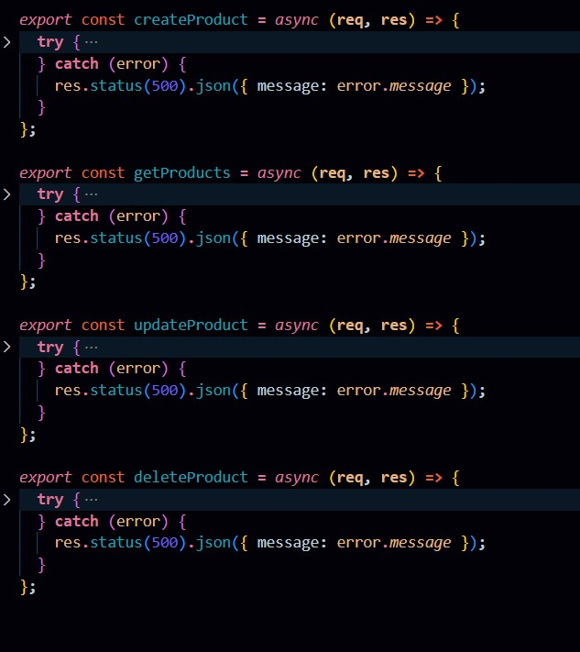
Auth Controllers
The Auth Controller manages all user authentication-related operations in the system. It handles user registration and login functionality while ensuring secure access using JWT tokens.
Responsibilities:
Register new users
Validate user input data
Hash passwords using bcrypt before storing
Authenticate users during login
Generate JWT tokens for authorized access
Send appropriate success and error responses
Main Functionalities:
Register User: Creates a new user account after validating email uniqueness and encrypting the password.
Login User: Verifies credentials and returns a JWT token for protected API access.
product.controller.js

Slide 10
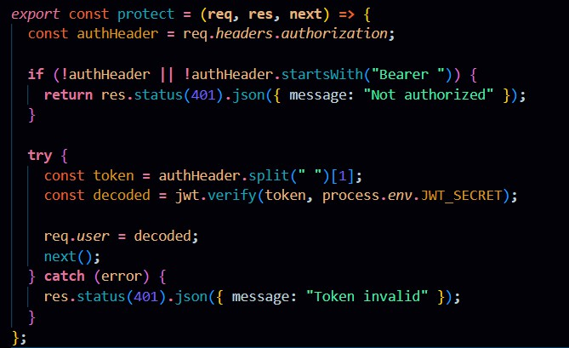
Product Controller
The Product Controller handles all product inventory operations and contains the business logic for managing products linked to individual users.
Responsibilities:
Add new products to inventory
Fetch products belonging to logged-in users
Update product details like price, quantity, or description
Delete products securely
Perform product search functionality
Main Functionalities:
Create Product: Adds a new product with a reference to the authenticated user.
Get Products: Retrieves only the products created by the logged-in user.
Update Product: Modifies product details while verifying ownership.
Delete Product: Removes a product safely from the database.
Search Product: Allows filtering products based on name.
Create Middleware
Inside: src/middlewares/
Create:auth.middleware.js

Slide 11
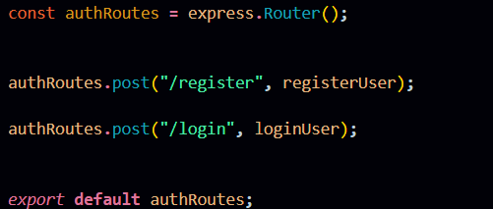
Auth Middleware (protect)
The Auth Middleware secures protected routes by verifying the JSON Web Token (JWT) sent in the request header. It checks for a valid Authorization header starting with "Bearer " and validates the token using the secret key. If the token is valid, the decoded user information is attached to req.user and the request proceeds to the next controller. If the token is missing or invalid, the middleware returns a 401 Unauthorized response, preventing access to private APIs.
Create Routes
Inside: src/routes/ Create: auth.routes.js
Auth Routes:
Auth routes handle user authentication by providing endpoints for registration and login. These routes connect incoming requests to the Auth Controller to create new users and generate JWT tokens for secure access.

Slide 12
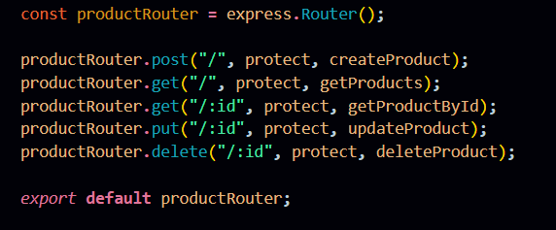

product.routes.js
Product Routes:
Product routes manage all inventory-related operations such as creating, retrieving, updating, and deleting products. These routes are protected using authentication middleware to ensure only authorized users can access their own product data.
Connect Routes to Server
Import all routes into server.js
These route configurations connect the authentication and product APIs to the main Express server using versioned endpoints. The /api/v1/auth path handles all user authentication requests, while /api/v1/products manages product-related operations, helping maintain a structured and scalable API architecture.
Database Configuration and Setup
Create MongoDB Atlas cluster
Add connection string to
.env
Connect DB before API testing.
Database Connection:
Create a file inside: src/db/db.js
Purpose: Connect backend to MongoDB using mongoose.

Slide 13
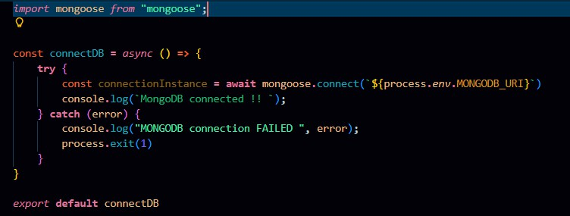
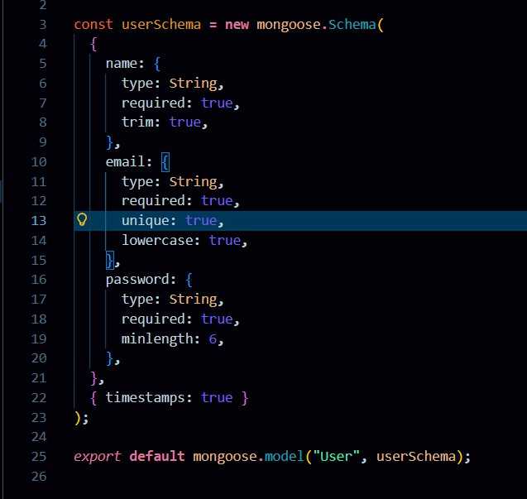
The connectDB function establishes a connection between the application and MongoDB using Mongoose and environment-based configuration. It ensures the server starts only after a successful database connection and logs an error message if the connection fails.
Create Models:
Inside src/models/ create:
User.js
Product.js
User Model:
User Schema:
The User schema defines the structure for storing user details such as name, email, and hashed password in the database. It supports secure authentication and maintains timestamps for record tracking.

Slide 14
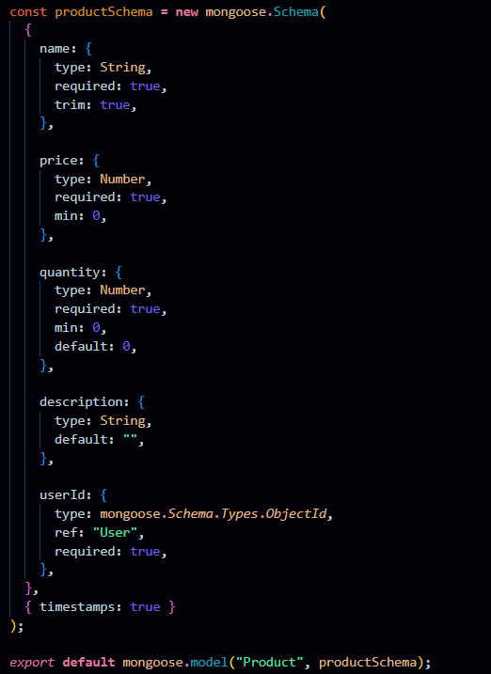
Product Model:
Product Schema:
The Product schema represents inventory items and includes fields like name, price, quantity, description, and a userId reference. It ensures each product is linked to its owner, enabling private data access and management.
Project Execution
Execution Steps
Open terminal in server folder.
Make sure you have a start script in the package.js file.
Run:
npm start
3. Console should display:
Server running on PORT Database Connected

Slide 15
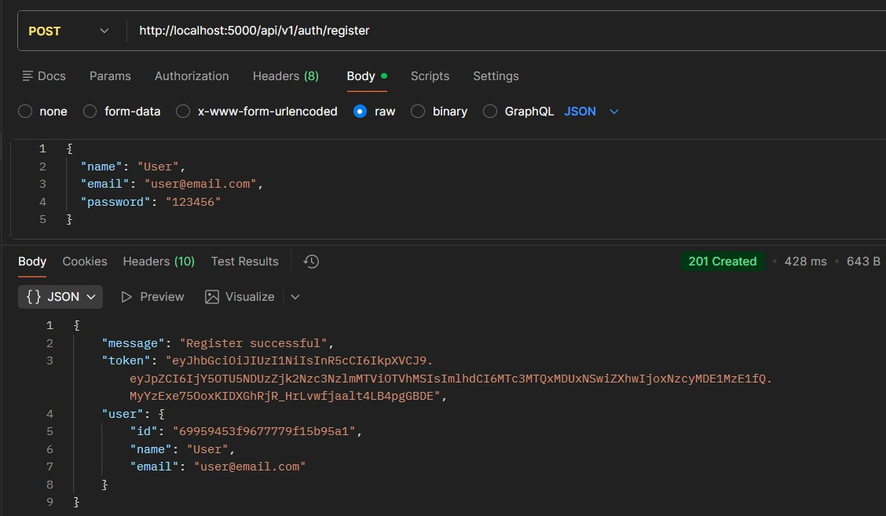
API Testing :
Use Thunder Client to test APIs:
Test APIs: Register User:
Register:
The register functionality allows new users to create an account by submitting their details, which are validated and securely stored with a hashed password. It ensures unique user creation before granting access to the system.

Slide 16
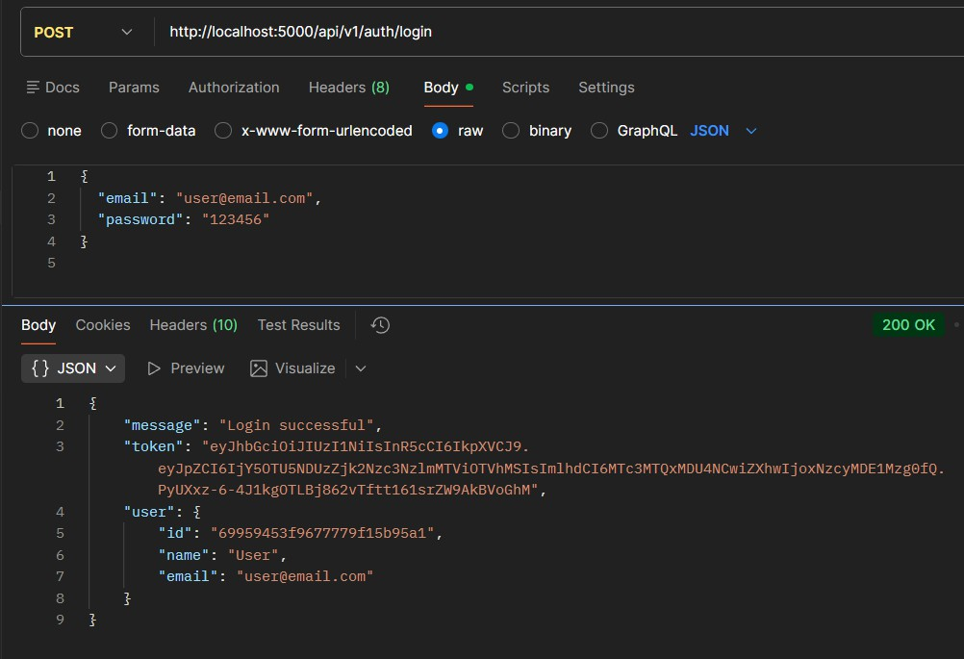
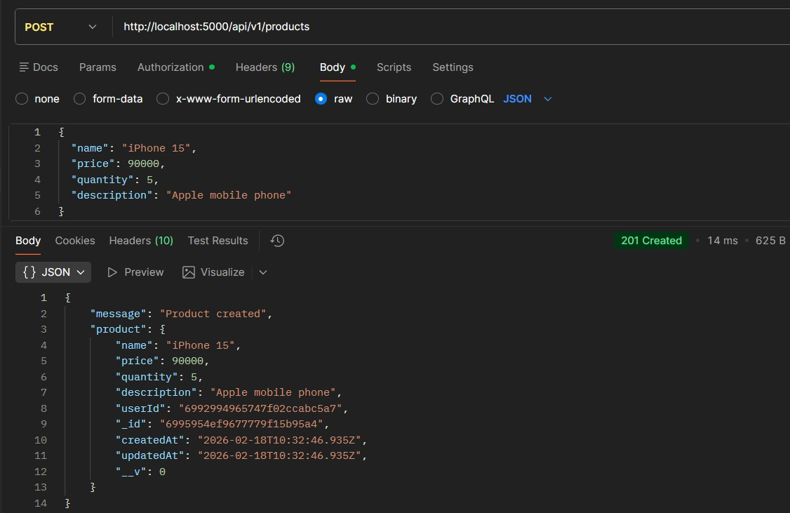
Login User
Login:
The login functionality verifies user credentials and generates a JWT token upon successful authentication. This token is used to access protected routes securely.
Create Product

Slide 17
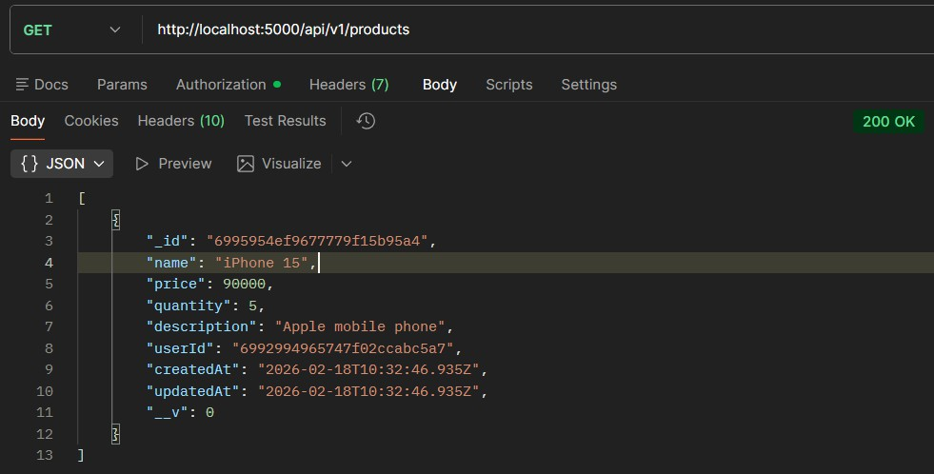
Create Product:
Allows an authenticated user to add a new product to their inventory by submitting product details. The product is saved with the user’s ID to maintain ownership.
Get all Products
Get all Products:
Fetches all products that belong to the logged-in user. It ensures users can view only their own inventory data.

Slide 18
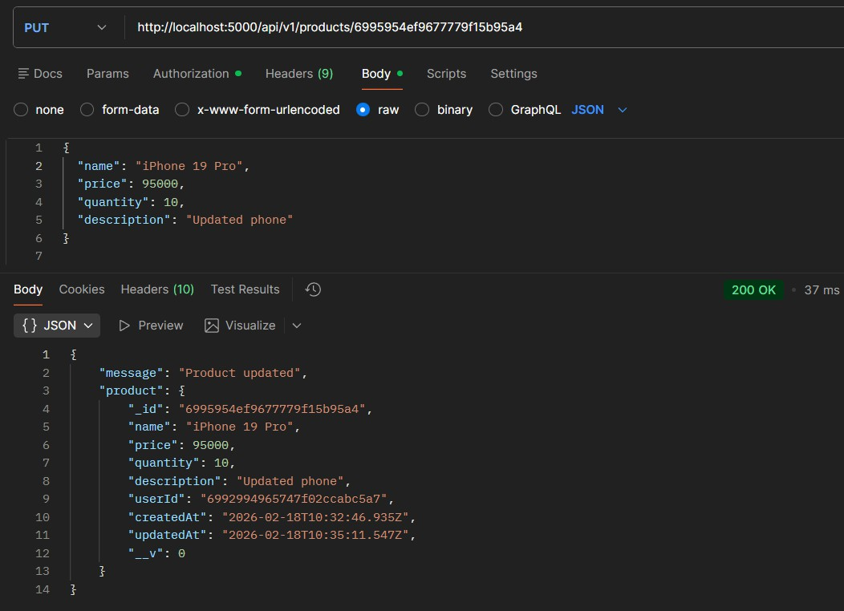
Update Product
Update Product:
Enables users to modify existing product details such as name, price, or quantity. The system verifies ownership before allowing any updates.

Slide 19
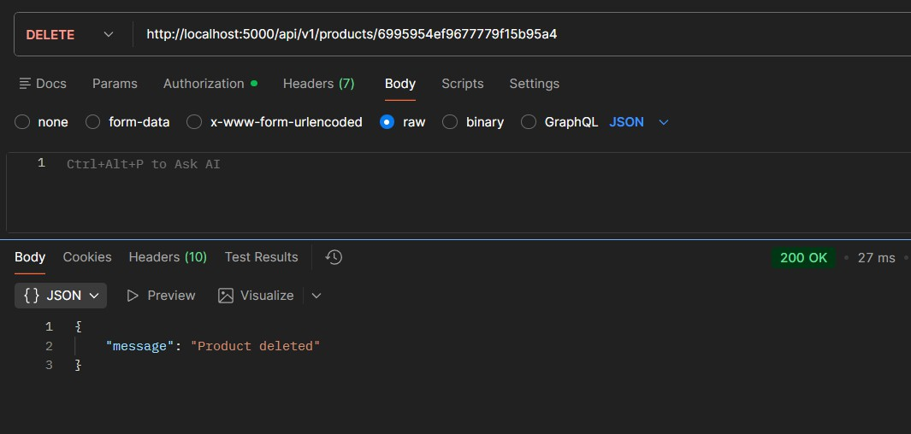
Delete Product
Delete Product:
Allows users to permanently remove a product from their inventory. The operation is protected to ensure only the product owner can delete it.
Project Demo Video:
Nm project vd.mp4

